Slide 1
Price of success

Slide 2
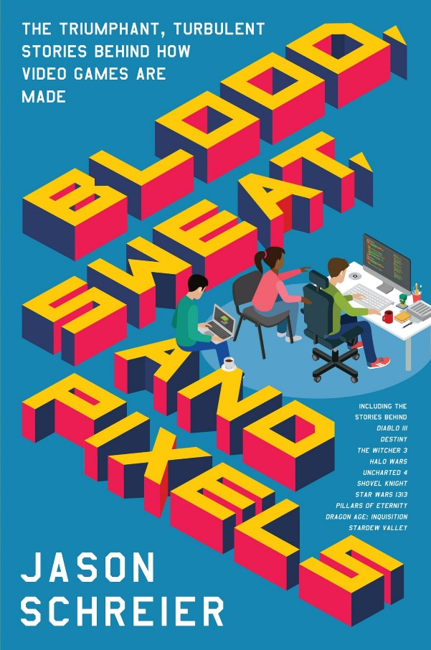
Before we start
Jason Schreier – Press Reset
Jason Schreier – Blood, Sweat and Pixels
David Kushner – Masters of Doom
Ars Technica – War stories

Slide 3
Crunch
Pillars of Eternity – Obsidian
Uncharted 4 – Naughty Dog

Slide 4
Crunch Culture
Epic Games - FortniteHiroshi Iuchi (Gunstar Heroes, Ikaruga) 1996.
EA Spouse 2004. (dvije tužbe – 15 milijuna svaka)
Rockstar SD wives 2010. (tužba 2009. 2.7 milijuna)
Jason Schreier – The Horrible World Of Video Game Crunch 2016.
Rockstar 2018.
EA BioWare – Anthem (BioWare Magic)
CD Project Red

Slide 5
2016. survey by the International Game Developers Association
65% of developers said they’d had to crunch
52% more than twice in the previous two years
32% “that their job did require periods of long hours, not called ‘crunch’”

Slide 6
FIN

